Slide 1
Ph.D candidate
Name Surname
Tutors
Name Surname (Tutor 1)
Name Surname (Tutor 2)

Slide 2
Description of the research program
Insert a short description of the research program.
The list of training activities and relative ECTS must not be included in this presentation.

Slide 3
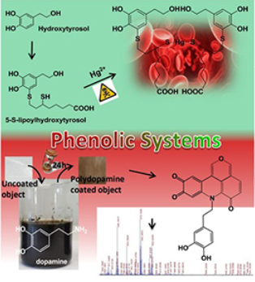
First research activity
Insert a description of the first research activities and the related papers (if any)
Y. Yorozu, M. Hirano, K. Oka, and Y. Tagawa, “Electron spectroscopy studies on magneto-optical media and plastic substrate interface,” IEEE Transl. J. Japan, vol. 2, pp. 740–741, August 1987 [Digest 9th Annual Conf. Magnetics Japan, p. 301, 1982].
J. Yamato, (2022, June). Recognizing human action in time-sequential images using hidden Markov model. In CVPR. (accepted and to appear)

Slide 4
Second research activity

Slide 5
List of the publications
Insert the list of papers written during the first year.
International Journal Articles
[j1] A. Einstein, "On the movement of small particles suspended in stationary liquids required by the molecular kinetic theory of heat." Ann. d. Phys 17.549-560 (1905): 1.
[j2] G. Eason, B. Noble, and I. N. Sneddon, “On certain integrals of Lipschitz-Hankel type involving products of Bessel functions,” Phil. Trans. Roy. Soc. London, (submitted)
International Conference Proceedings
[c1] Y. Yorozu, M. Hirano, K. Oka, and Y. Tagawa, “Electron spectroscopy studies on magneto-optical media and plastic substrate interface,” IEEE Transl. J. Japan, vol. 2, pp. 740–741, August 1987 [Digest 9th Annual Conf. Magnetics Japan, p. 301, 1982].
[c2] J. Yamato, (2022, June). Recognizing human action in time-sequential images using hidden Markov model. In CVPR. (accepted and to appear)
Other publications
[g1] M. Young, The Technical Writer’s Handbook. Mill Valley, CA: University Science, 1989.

Slide 6
Thank you for your attention!

